Slide 1
Machine Learning AIML CZG565
Unsupervised Learning
Course Faculty of M.Tech Cluster
BITS – CSIS - WILP

Slide 2

Machine Learning
Disclaimer and Acknowledgement
These content of modules & context under topics are planned by the course owner Dr. Sugata, with grateful acknowledgement to many others who made their course materials freely available online
We here by acknowledge all the contributors for their material and inputs.
We have provided source information wherever necessary
Students are requested to refer to the textbook w.r.t detailed content of the presentation deck shared over canvas
We have reduced the slides from canvas and modified the content flow to suit the requirements of the course and for ease of class presentation
Slide Source / Preparation / Review:
From BITS Pilani WILP: Profs.Sugata, Chetana, Rajavadhana, Monali, Seetha, Vimal, Swarna
External: CS109 and CS229 Stanford lecture notes, Dr.Andrew NG and many others who made their course materials freely available online

Slide 3
Course Plan
M1 | Introduction & Mathematical Preliminaries
M2 | Machine Learning Workflow
M3 | Linear Models for Regression
M4 | Linear Models for Classification
M5 | Decision Tree
M6 | Instance Based Learning
M7 | Support Vector Machine
M8 | Bayesian Learning
M9 | Ensemble Learning
M10 | Unsupervised Learning
M11 | Machine Learning Model Evaluation/Comparison

Slide 4
Module –Unsupervised Learning
Mixture Models
Expectation Maximization (EM) Algorithm
K-means Clustering

Slide 5


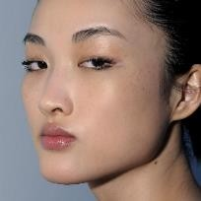
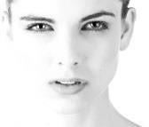

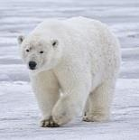
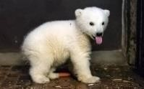
Unsupervised discovery
Task : Group the objects based on the characterisitics features
Input:
Structured data of features like colour , shape, size, etc.,
Process: Find the similarity/dissimlarity between objects with features as the defining dimensions
Output:
Group/Cluster of objects

Slide 6
K-Means

Slide 7
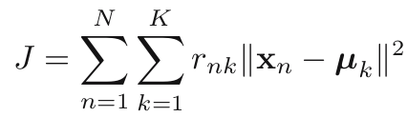
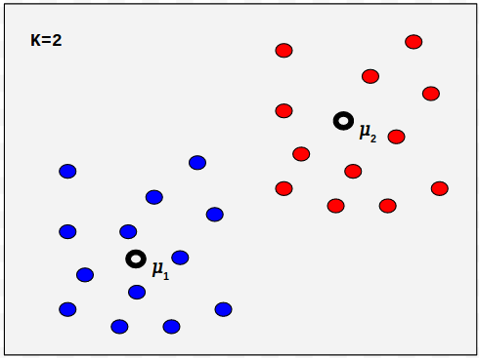
K-Means Algorithm
Works iteratively to find {𝜇_{k}}and {r_{nk}} such that J is minimized
Iteration involves two key steps
Find {r_{nk}} , fixing {𝜇_{k}} to minimize J
Find {𝜇_{k}} , fixing {r_{nk}} to minimize J
Let us look at each of these steps

Slide 8
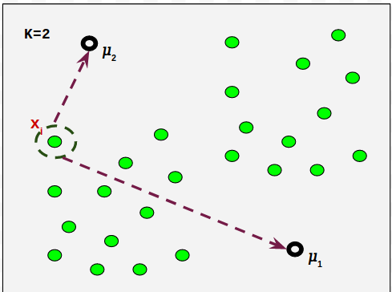
K-Means Algorithm
A sample E-Step

Slide 9
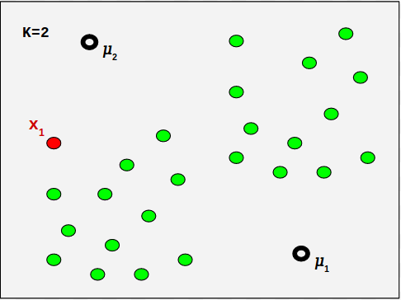
K-Means Algorithm
A sample E-Step

Slide 10
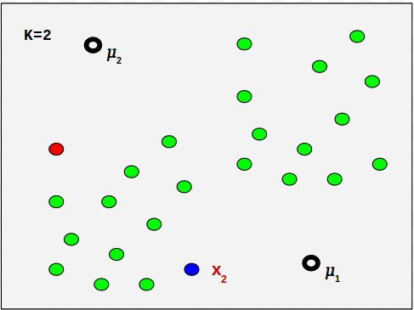
K-Means Algorithm
A sample E-Step

Slide 11
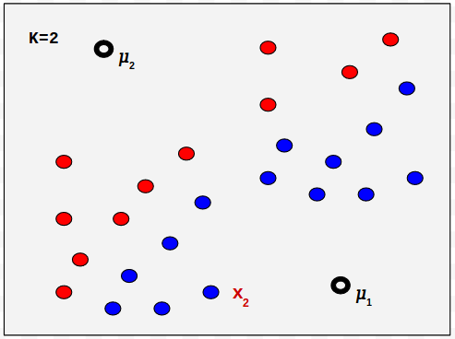
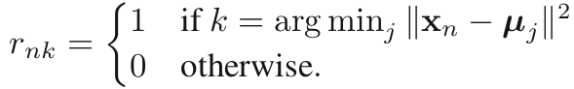
K-Means Algorithm
E-Step:
For all x_{t} ∊ X:

Slide 12
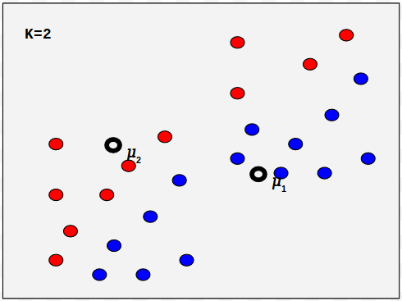
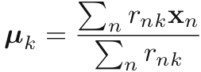
K-Means Algorithm
M-Step:
For all 𝜇_{k}[where k = 1,2,...,K ] :

Slide 13
K-Means Algorithm
Algorithm:
Initialize 𝜇_{k}[where k = 1,2,...,K ]
Repeat
E-Step [as defined earlier]
M-Step [as defined earlier]
Until convergence of 𝜇_{k} .

Slide 14
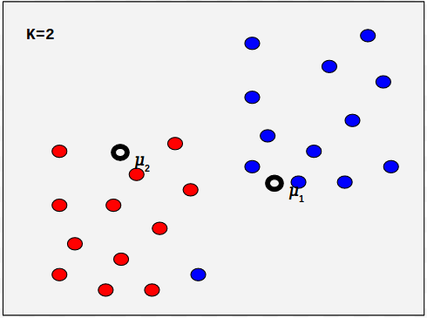
K-Means Algorithm
Algorithm:
Initialize 𝜇_{k}[where k = 1,2,...,K ]
Repeat
E-Step [as defined earlier]
M-Step [as defined earlier]
Until convergence of 𝜇_{k} .
E-Step in the second iteration

Slide 15
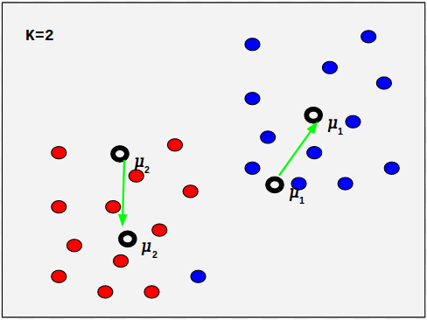
K-Means Algorithm
Algorithm:
Initialize 𝜇_{k}[where k = 1,2,...,K ]
Repeat
E-Step [as defined earlier]
M-Step [as defined earlier]
Until convergence of 𝜇_{k} .
M-Step in the second iteration

Slide 16
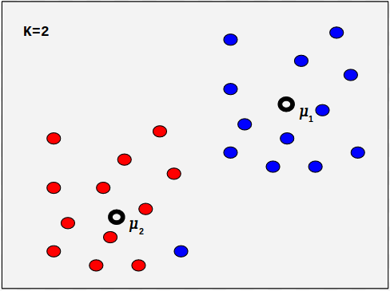
K-Means Algorithm
Algorithm:
Initialize 𝜇_{k}[where k = 1,2,...,K ]
Repeat
E-Step [as defined earlier]
M-Step [as defined earlier]
Until convergence of 𝜇_{k} .
M-Step in the second iteration

Slide 17
Example
Consider the analysis of weights of individuals and their respective blood glucose levels as given below:
Identify the clusters using K-means clustering (k=2) for the given data, assuming candidate 1 and 2 as initial centroids.
How many iterations does it take before termination?
Candidate | Weight | Glucose level
1 | 72 | 185
2 | 56 | 170
3 | 60 | 168
4 | 68 | 179
5 | 72 | 182
6 | 77 | 188
7 | 70 | 180
8 | 84 | 183

Slide 18
Example
Candidate | Cluster1(72, 185) | Cluster2(56, 170)
3(60, 168) | =17² +12² | = 2²+4²
4(68 179) | =6²+4² | = 9²+12²
5(72, 182) | = 3²+0² | = 12²+16²
6(77, 188) | = 3²+5² | = 18²+11²
7(70, 180) | = 5²+2² | = 10²+14²
8(183, 84) | = 2²+12² | = 13²+28²
After 1st iteration, the cluster groups are C1{1, 4, 5, 6, 7, 8} and C2{2, 3}
Re-computing centroids:
C1( [72+68+72+77+70+84]/6, [185 +179+182+188+180+183]/6 ) =C1(73.83, 182.83,)
C2( [56 +60]/2, [170+168]/2) =C2(58, 169)
2nd Iteration –computing distances from resulting centroids:
Candidate | Cluster1(182.83, 73.83) | Cluster2(169, 58)
1(185, 72) | (182.83 -185)² +(73.83 -72)² =2.17² +1.83² | (169 -185)² +(58 -72)² = 16²+14²
2(170, 56) | (182.83 -170)² +(73.83 -56)² =12.83² +17.83² | (169 -170)² +(58 -56)² = 1²+2²
3(168, 60) | (182.83 -168)² +(73.83 -60)² =14.83² +13.83² | (169 -168)² +(58 -60)² = 1²+2²
4(179, 68) | (182.83 -179)² +(73.83 -68)² =3.83² +5.83² | (169 -179)² +(58 -68)² = 10²+10²
5(182, 72) | (182.83 -182)² +(73.83 -72)² =0.83² +1.83² | (169 -182)² +(58 -72)² = 13²+14²
6(188, 77) | (182.83 -188)² +(73.83 -77)² =5.17² +3.17² | (169 -188)² +(58 -77)² = 19²+19²
7(180, 70) | (182.83 -180)² +(73.83 -70)² =2.17² +1.83² | (169 -180)² +(58 -70)² = 11²+12²
8(183, 84) | (182.83 -183)² +(73.83 -84)² = 0.17²+10.17² | (169 -183)² +(58 -84)² = 14²+26²
After 2nd iteration, the cluster groups are C1{1, 4, 5, 6, 7, 8} and C2{2, 3}; there is no change in cluster groups hence the algorithm terminates.

Slide 19
Evaluating K-means Clusters
Most common measure is Sum of Squared Error (SSE)
For each point, the error is the distance to the nearest cluster
To get SSE, we square these errors and sum them.
x is a data point in cluster C_{i} and m_{i} is the representative point for cluster C_{i}
can show that m_{i} corresponds to the center (mean) of the cluster
Given two clusters, we can choose the one with the smallest error
One easy way to reduce SSE is to increase K, the number of clusters
A good clustering with smaller K can have a lower SSE than a poor clustering with higher K

Slide 20
Importance of Choosing Initial Centroids

Slide 21
Importance of Choosing Initial Centroids

Slide 22
Importance of Choosing Initial Centroids …

Slide 23
Importance of Choosing Initial Centroids …

Slide 24
Limitations of K-means
K-means has problems when clusters are of differing
Sizes
Densities
Non-globular shapes
K-means has problems when the data contains outliers.

Slide 25
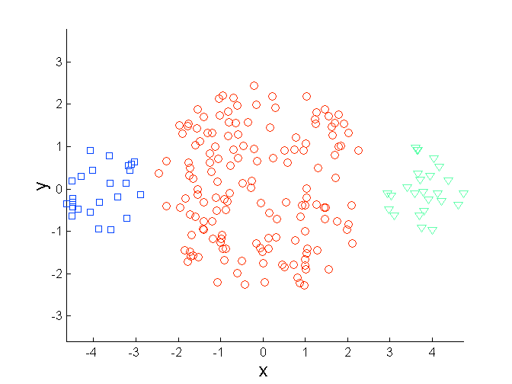
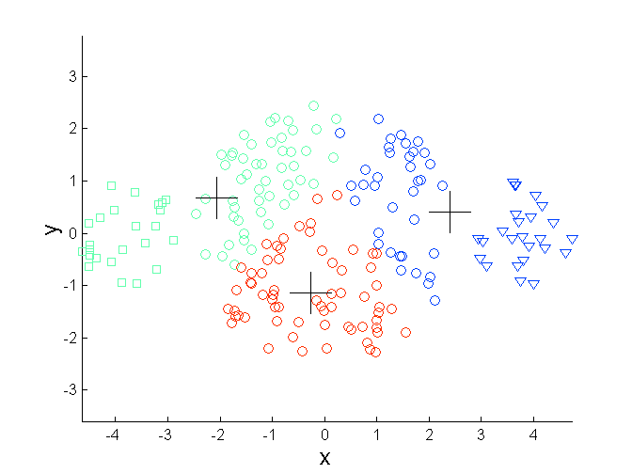
Limitations of K-means: Differing Sizes
Original Points
K-means (3 Clusters)

Slide 26
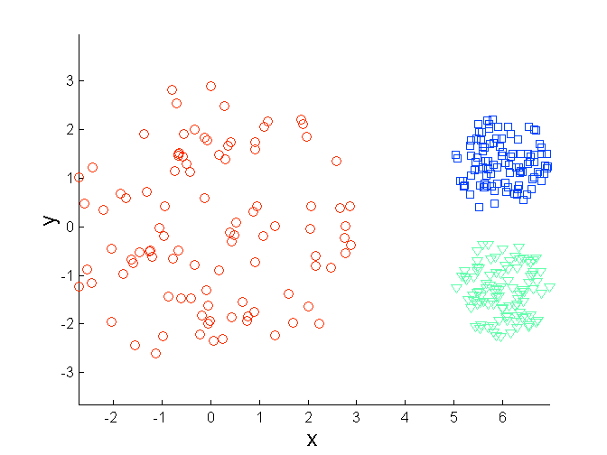
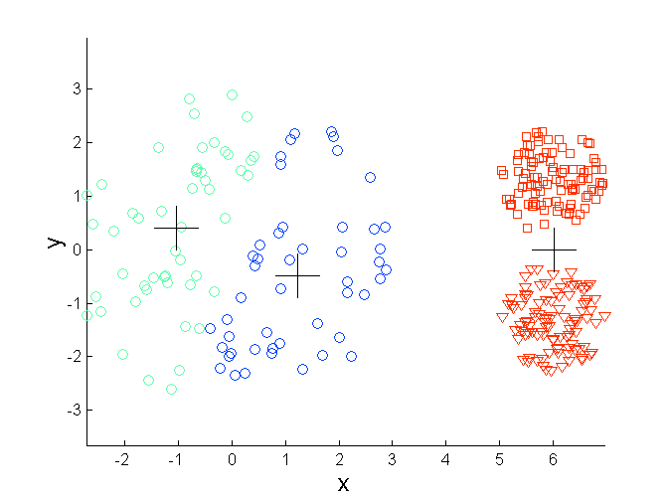
Limitations of K-means: Differing Density
Original Points
K-means (3 Clusters)

Slide 27
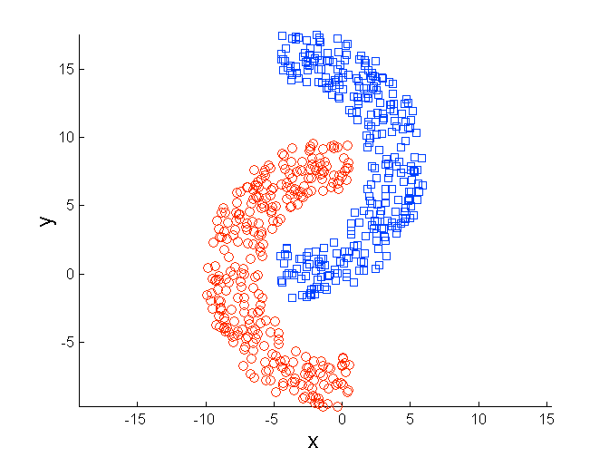
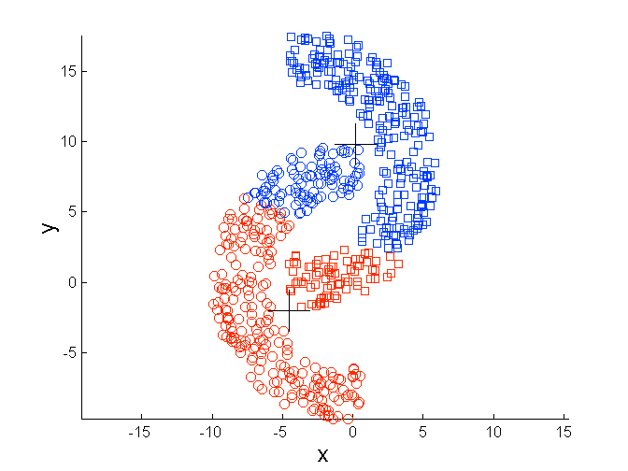
Limitations of K-means: Non-globular Shapes
Original Points
K-means (2 Clusters)

Slide 28
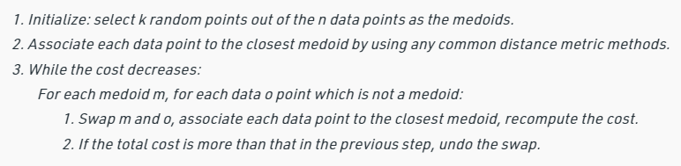
From K-Means to K-Medoids
The k-means is sensitive to outliers-since an object with an extremely large value may substantially distort the distribution of the data
K-Medoids: Instead of taking the mean value of the object in a cluster as a reference point, medoids can be used, which is the most centrally located object in a cluster
K-Medoids

Slide 29
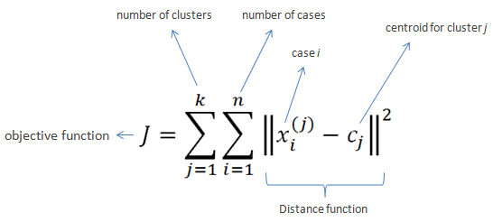
How to choose a “good” k for k-means clustering?
Choose the number of clusters by visually inspecting data points
Elbow method:
Compute the sum of squared error (SSE) for some values of k (for example, 2,3,4,5,6…). The SSE is defined as the sum of the squared distance between each member of the cluster and its centroid.
If you plot k against SSE, you will see that the error decreases as k gets larger, this is because when the number of clusters increases, they should be smaller, so distortion is also smaller. The idea of the elbow method is to choose the k at which the SSE decreases abruptly.

Slide 30
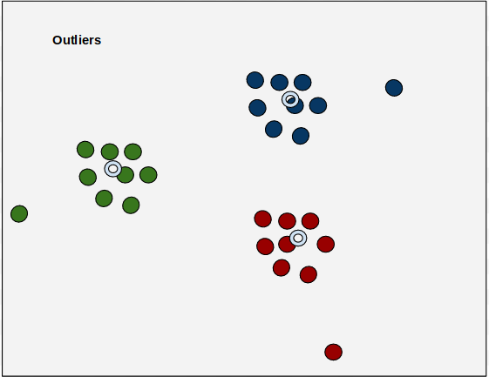
(naive) K-Means for detecting outliers
Let
dist(x, 𝜇_{k}) be the distance of a point x, assigned to cluster k to its center 𝜇_{k}.
L𝜇_{k} be the the average distance of all the points assigned to cluster k with its center
The ratio dist(x, 𝜇_{k}) / L𝜇_{k} for each point is the outlier score for each point.
Higher the ratio for a point x, more likely x is an outlier

Slide 31
Notion of Mixture Models

Slide 32
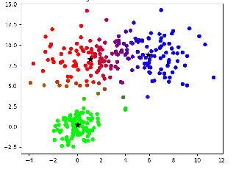

K means – Hard clustering
Assigned each example to exactly one cluster
What if clusters are overlapping?
Hard to tell which cluster is right
Maybe we should try to remain uncertain
What if cluster has a non-circular shape?
Hard assignments of data points to clusters – small shift of a data point can flip it to a different cluster
For example, if a point is near the 'border' between two clusters, it's often better to know that it has near equal membership probabilities for these clusters, rather than blindly assigning it to the nearest one.
0
190
intensity
255

Slide 33
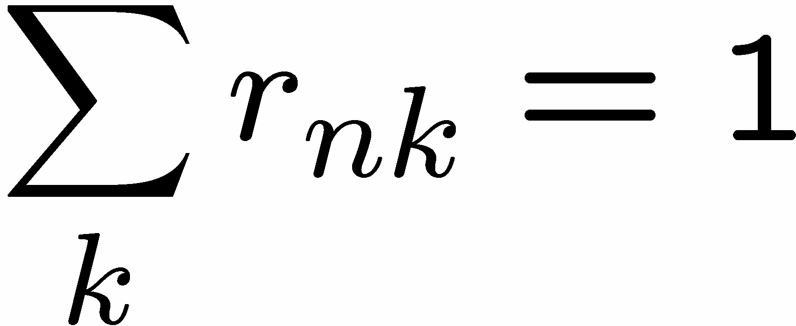
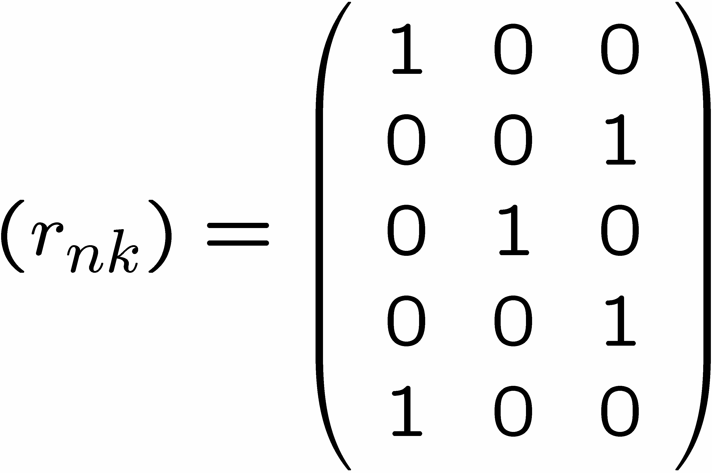
1 of K coding mechanism
For each data point x_{n}, we introduce a set of binary indicator variables r_{nk} ∈ [0,1] such that
where k =1,...,K describing which of the K clusters the data point x_{n} is assigned to, so that if data point x_{n} is assigned to cluster k then r_{nk} > r_{nj} for j not equal to k.
Example: 5 data points and 3 clusters

Slide 34
GMM - soft Clustering
Solution: replace ‘hard’ clustering of K-means with ‘soft’ probabilistic assignments
Probabilistic Clustering
Represents the probability distribution of the data as a Gaussian mixture model (GMM)
GMMs give a probabilistic assignment of points to clusters which quantify uncertainty.
Mixture models combines a set of distributions to create a convex space where we can search for the optimal parameters for such distributions using MLE.
In GMM, Clusters modeled as Gaussians
EM algorithm: assign data to cluster with some probability

Slide 35
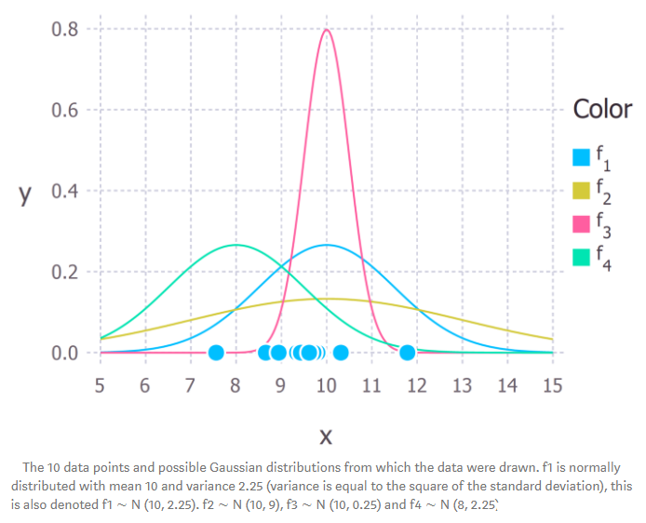
Gaussian Distribution
The normal curve is bell-shaped and has a single peak at the
exact center of the distribution.
The arithmetic mean, median, and mode of the distribution are equal and located at the peak.
Half the area under the curve is above the peak, and the other half is below it.
The normal distribution is symmetrical about its mean.

Slide 36
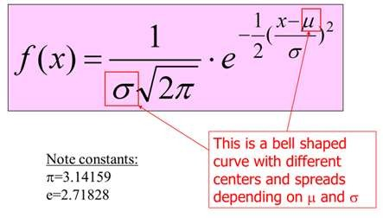
MATHEMATICAL FUNCTION (Pdf)

Slide 37
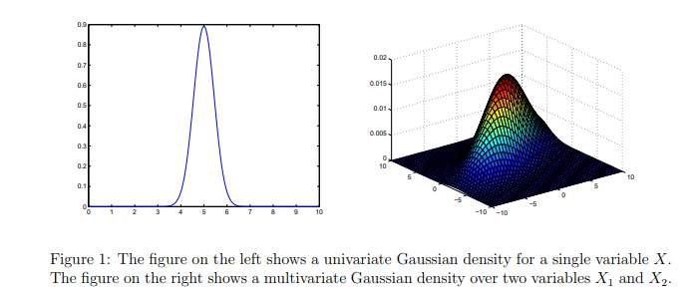
Univariate and Multivariate Gaussian density

Slide 38
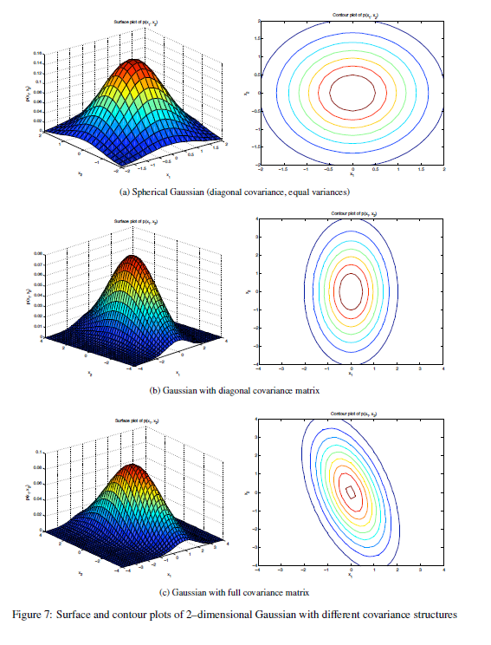
2-dimensional Gaussian distribution

Slide 39
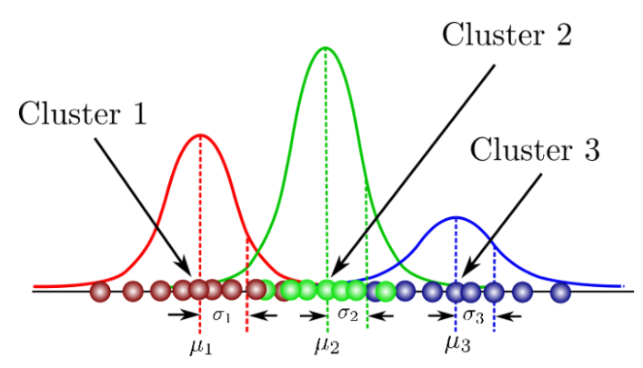
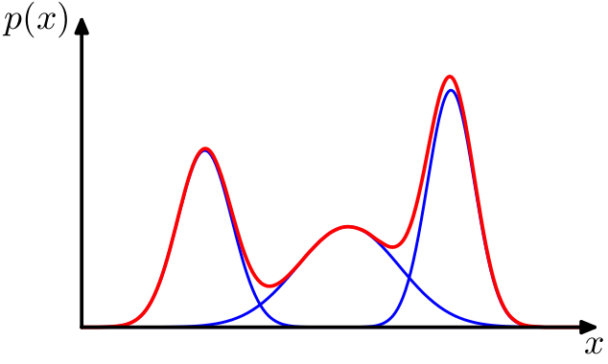
GMM – Mixture of Gaussians
Probabilistic cluster is a distribution over the data space, which can be mathematically represented using a probability density function (or distribution function).
Our task: infer a set of k probabilistic clusters that is mostly likely to generate D

Slide 40
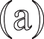


Example: Mixture of 3 Gaussians
x
2
x
2
x
2
x
1
x
1
x
1
(a)
(b)
(c)
The observed data come from a Gaussian mixture distribution which consists of K Gaussians with their own means and variances.
K classes are latent

Slide 41
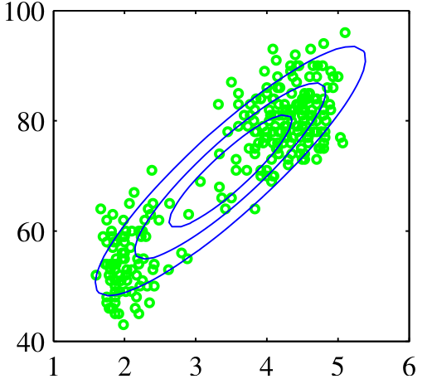
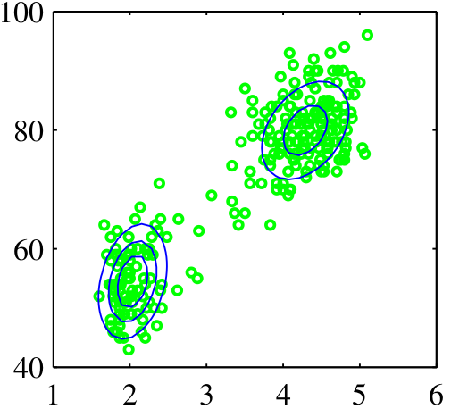
GMM – Why single distribution is insufficient
Gaussian distribution is that it is intrinsically unimodal
A single distribution is not sufficient to fit many real data sets which is multimodal
A mixture model assumes that a set of observed objects is a mixture of instances from multiple probabilistic clusters, and conceptually each observed object is generated independently
Time to next Geyser Eruptions (in Mins)
Length of Geyser Eruptions (in Mins)
Time to next Geyser Eruptions (in Mins)
Length of Geyser Eruptions (in Mins)

Slide 42
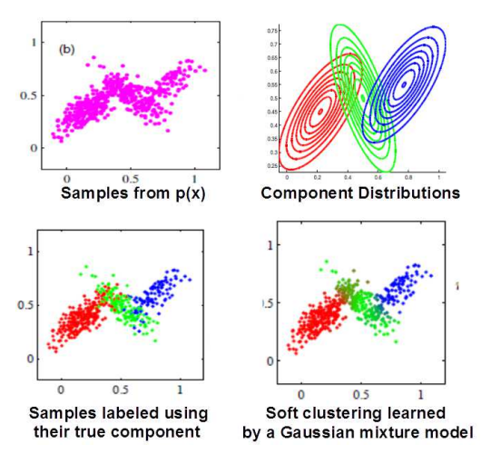
Learning a Mixture of Gaussians
Our actual observations
Mixture of 3 Gaussians
Source Credit :
CS229: Machine Learning
©2021 Carlos Guestrin

Slide 43
Gaussian Mixture Model
A Gaussian mixture model is a probabilistic model that assumes all the data points are generated from a mixture of a finite number of Gaussian distributions with unknown parameters.
A Gaussian Mixture is a function that is comprised of several Gaussians, each identified by k ∈ {1,…, K}, where K is the number of clusters of our dataset. Each Gaussian k in the mixture is comprised of the following parameters:
A mean μ that defines its centre.
A covariance Σ that defines its width. This would be equivalent to the dimensions of an ellipsoid in a multivariate scenario.
A mixing probability π that defines how big or small the Gaussian function will be.
https://scikit-learn.org/stable/modules/mixture.html

Slide 44
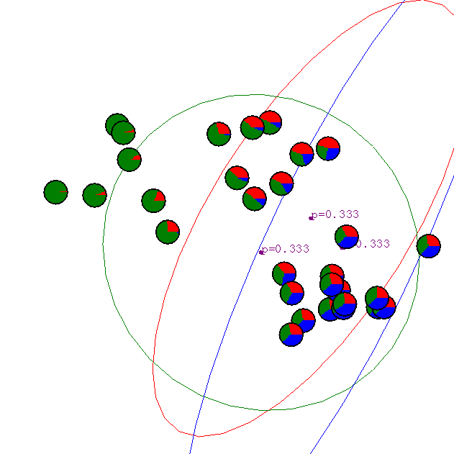
Gaussian Mixture Example: Start

Slide 45
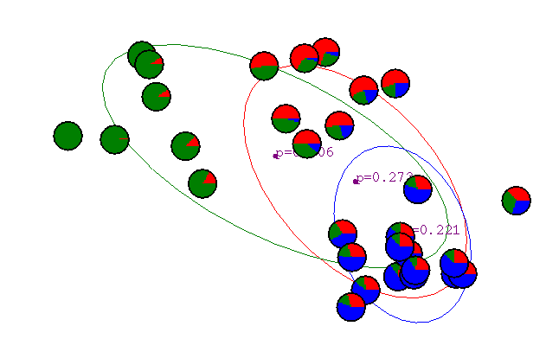
After first iteration
Slide Credit: Andrew W. Moore

Slide 46

After 2nd iteration
Slide Credit: Andrew W. Moore

Slide 47

After 3rd iteration
Slide Credit: Andrew W. Moore

Slide 48

After 4th iteration
Slide Credit: Andrew W. Moore

Slide 49

After 5th iteration
Slide Credit: Andrew W. Moore

Slide 50

After 6th iteration
Slide Credit: Andrew W. Moore

Slide 51

After 20th iteration
Slide Credit: Andrew W. Moore

Slide 52
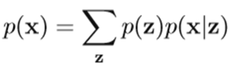
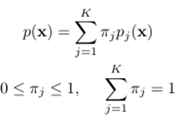
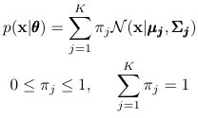
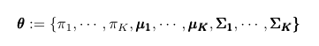
GMM equations
Mixture models
K = number of mixture components (clusters),
πⱼ = mixture weights
pⱼ(x) = family of distributions
(Gaussian, Bernoulli, etc).
Gaussian Mixture models
θ = collection of all the parameters of the model (mixture weights, means, and covariance matrices):

Slide 53
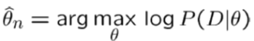
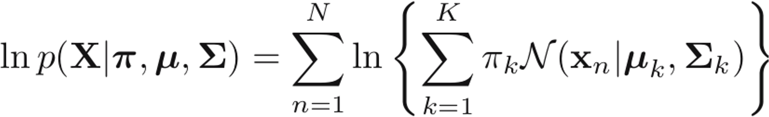
General EM algorithm
Observed data: D={x1, …….., xn}
Unknown variables: y
In clustering: y=1….K clusters
Parameters: θ
In GMM : θ= π : {π1, . . . , πk}
μ : {μ1 , . . . , μK}
Σ : {Σ1, . . . ΣK }
Goal:
In GMM :

Slide 54
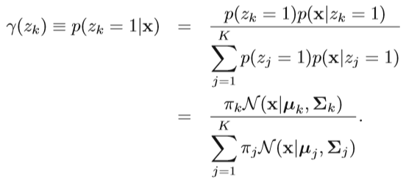
EM algorithm for GMM
E step:
Evaluate the responsibilities (posterior probabilities) using the current parameter
For each example x_{n},
Compute γ​(z_{nk})​ the probability that x_{n}​ is generated by component Z_{k} i.e it belongs to cluster k
If x_{n} is very likely under the k_{th} Gaussian, it gets high weight

Slide 55
EM algorithm for GMM
M-Step :
maximize the expectation of the complete-data log-likelihood, computed with respect to the conditional probabilities found in the Expectation step. The result of the maximization is a new parameter vector μnew , Σnew and πnew
Keep 𝛾 (znk ) fixed, and apply MLE for maximizing of ln p(X|π,µ,Σ) for μk , Σk and πk, to get μnew , Σnew and πnew
Repeat E & M until convergence
In practice, the algorithm is deemed to have converged when the change in the log likelihood function, or alternatively in the parameters, falls below some threshold

Slide 56
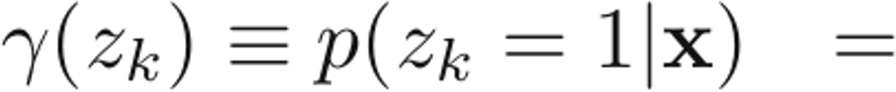
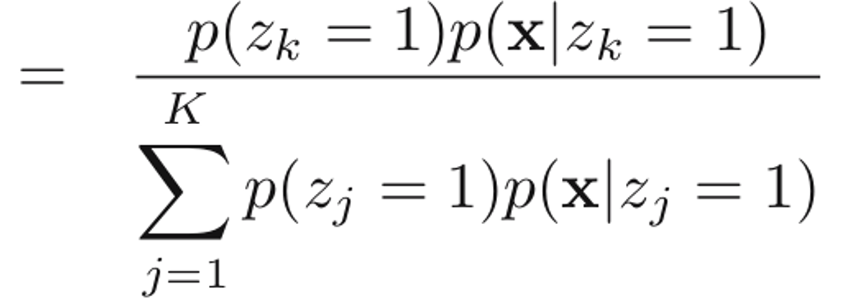
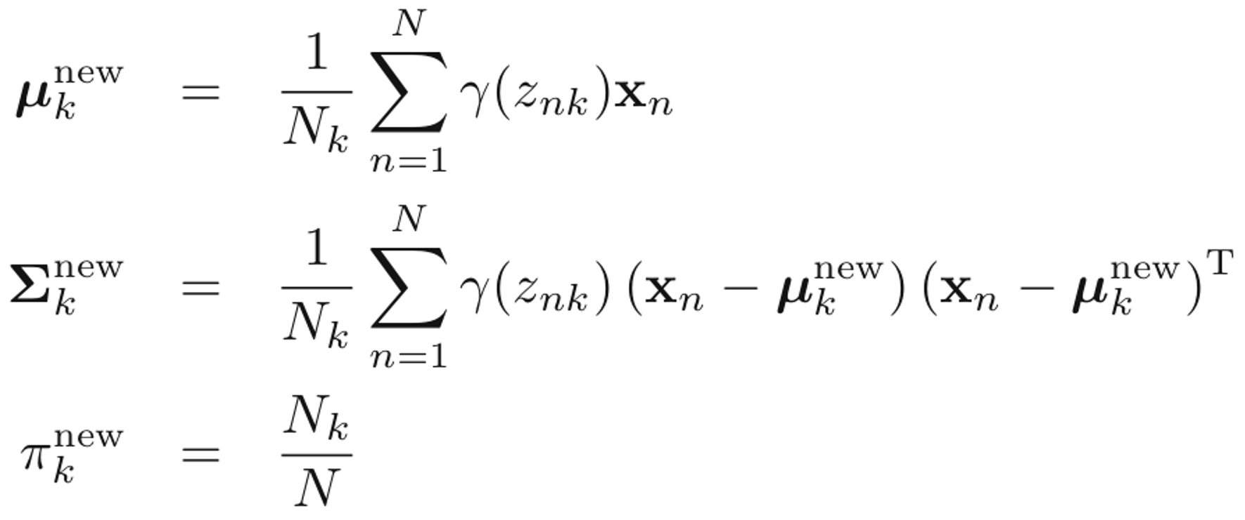



EM algorithm for GMM
To Estimate:
M-Step
Initialize 𝝿, 𝜇,Σ and
E-Step
also evaluate the log likelihood
Perform E-Step Given 𝛾(z_{k})
Perform M-Step Given 𝝿, 𝜇,Σ
Repeat Until
Convergence
N_{k} = the effective number of points assigned to cluster k

Slide 57
EM Algorithm
I Standardize the data if required:
II Fix the no.of.cluster expected
III Initialize the prototypes:
Mean, Covariance, Weights
IV Expectation-Step: Fix prototype & find the membership of each point weighted by the probability value
V. Calculate the log likelihood of the points
VI Maximization Step: Fix the membership(responsibility matrix) and re-estimate the prototypes
VII Calculate the new log likelihood of the points. Repeat E & M Step till convergence is achieved:

Slide 58





GMM
IV Expectation-Step: Fix prototype & find the membership of each point weighted by the probability value
Sample calculation for this step is shown below:
Weight1*N1 =
0.5* $P\left(Doc1, Cluter1\right)$
$$= \left(Doc1, \left(3,3\right), \left(4,0.707\right)\right)$$
$=0.5∗\frac{e^{\frac{−({2−3)}^{2}}{2∗4^{2}}}}{4∗\sqrt[2]{2∗3.14}}$* $\frac{e^{\frac{−({2−3)}^{2}}{2∗{0.707}^{2}}}}{0.707∗\sqrt[2]{2∗3.14}}$
= 0.01004
$$For Cluster 1 assumed parameters, here for Doc1$$
$$apply in the below formula and$$
$multiply with the weight=0.5$. For simplicity , assume off diagonal values in covariance matrix as 0 (This is usually done in text analysis use cases). similarly do it for all the Doc’s

Slide 59

GMM
IV Expectation-Step: Fix prototype & find the membership of each point weighted by the probability value
Similarly:$For Cluster 2 assumed parameters, here for Doc1$
$$apply in the below formula and$$
$multiply with the weight=0.5$. For simplicity , assume off diagonal values in covariance matrix as 0(This is usually done in text analysis use cases). similarly do it for all the Doc’s

Slide 60
GMM
Per Docs sum the previous two found values.
This gives the denominator of this formula
For Doc2 :
Weight1*N1 = 0.0005
Weight2*N2 = 0.0828
Sum = 0.08329 = ~0.0833
P(ZDoc1-Cluster1) = 0.006
P(ZDoc1-Cluster1) = 0.994
Now find the membership of doc :
P(Zi1) = dividing Weight1*N1 by Sum
P(Zi2) = dividing Weight2*N1 by Sum
Similarly do it for all the Doc’s

Slide 61
GMM
V. Calculate the log likelihood of the points
Log likehood =
ln(0.010) + ln(0.083) + ln(0.006)
=-12.16
Log likelihood = ln(sum of Doc1) + ln(sum of Doc2 + ln(Sum of Doc3)….
This value needs to be found for every iteration and at one iteration it will approach a very large value . That will be one of the stopping convergence point of the algorithm.

Slide 62



GMM
VI Maximization Step: Fix the membership(responsibility matrix) and re-estimate the prototypes
Sample calculations shown below
Nk=1 = Cluster 1 =
= 0.9999+0.006+1
=2.0059
This is the value N1 represented here
MEANk=1 =
(4.49, 2.00) = ~(4.49,2)
$$\text{Std}\text{.}\text{DeVk}\text{=1}=$$
( $\text{[}\text{0.9999}{\text{(2−4.49)}}^{2}+\text{0.006}{\text{(}\text{4}\text{−4.49)}}^{2}+\text{1}{\text{(}\text{7}\text{−4.49)}}^{2}]/N1$ ,
$\text{[}\text{0.9999}{\text{(2−}\text{2}\text{)}}^{2}+\text{0.006}{\text{(}\text{5}\text{−}\text{2}\text{)}}^{2}+\text{1}{\text{(}\text{2}\text{−}\text{2}\text{)}}^{2}]/N1$)
= (6.23, 0.03)
N1 for cluster k=1 is got by summing these.
Similarly do it for N2
For cluster k=1 is Means obtained by
multiplying the data by the membership.
[0.9999(2) + 0.006(4) + 1(7)]/N1 , [0.9999(2) + 0.006(5) + 1(2)]/N1
Similarly do it for cluster 2
Weightk=cluster1 (new)
= 2.0059/3 = 0.67

Slide 63
GMM - EM Algorithm
2nd Iteration continues
I Standardize the data if required:
II Fix the no.of.cluster expected
III Initialize the prototypes:
Mean, Covariance, Weights
IV Expectation-Step: Fix prototype & find the membership of each point weighted by the probability value
V. Calculate the log likelihood of the points
VI Maximization Step: Fix the membership(responsibility matrix) and re-estimate the prototypes
VII Calculate the new log likelihood of the points. Repeat E & M Step till convergence is achieved:

Slide 64

Gaussian Mixture Model
Note:
The GMM model can be relaxed
by setting these parameters
while calling the function
"spherical": all clusters must be spherical, but they can have different diameters (i.e., different variances).
"diag": clusters can take on any ellipsoidal shape of any size, but the ellipsoid’s axes must be parallel to the coordinate axes (i.e., the covariance matrices must be diagonal).
"tied": all clusters must have the same ellipsoidal shape, size and orientation (i.e., all clusters share the same covariance matrix).

Slide 65

Gaussian Mixture Model
from sklearn.mixture import GaussianMixture
gm = GaussianMixture(n_components=3, n_init=10)
gm.fit(X)
gm.weights_
gm.means_
gm.covariances_

Slide 66
References
Christopher Bishop: Pattern Recognition and Machine Learning, Springer International Edition
https://www.youtube.com/watch?v=TG6Bh-NFhA0
https://www.youtube.com/watch?v=qMTuMa86NzU

